Slide 1
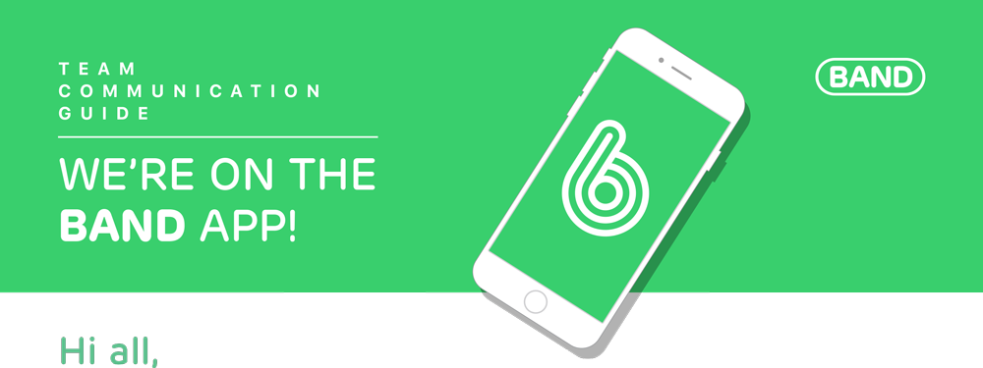
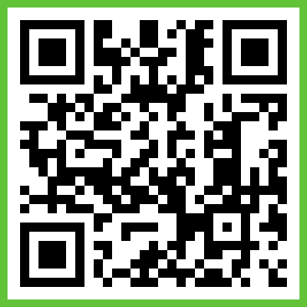
We’re excited to announce that this year our Troop will be using BAND to communicate. This will help us stay on the same page without cluttering our inboxes.
What is BAND? BAND is a free group communication app that helps organize teams. We can communicate privately and share content all in one place.
Your Responsibility BAND is an interactive space. Leave comments and ask questions. Voice your opinion through Polls. RSVP to events. Chat with other members. We ask that you turn on the app notifications so that you can stay up to date and respond on time.
How We’ll Use It We’ll share EVERYTHING related to our group. That includes announcements, schedules, last minute changes, files, photos/videos and so on. All group information will be at your fingertips so you won’t have to rely on me or anyone else for information. Not sure about something? Check the Band first.
Let’s Get Started! Click the link below, download the app, and sign up. Once signed in, you’ll be directed to our group Band. (if not, click the link again). Please have your Leader/Scout BSA ID handy since you will be asked for it before you get accepted into our BAND group.
URL: https://band.us/n/a7acz0J2T8L1Y QR Code:

